Slide 1

ScholarRAG
AI-Powered Literature Assistant
Final Presentation · CSCI 544
Sushil Dalavi · Parvathi Sanjana Pericherla · Eshna Gupta
University of Southern California
Notes:
SPEAKER: [Name] ~30 sec Welcome. We're presenting ScholarRAG — a trust-first literature assistant. Our team is Sushil, Parvathi, and Eshna.

Slide 2
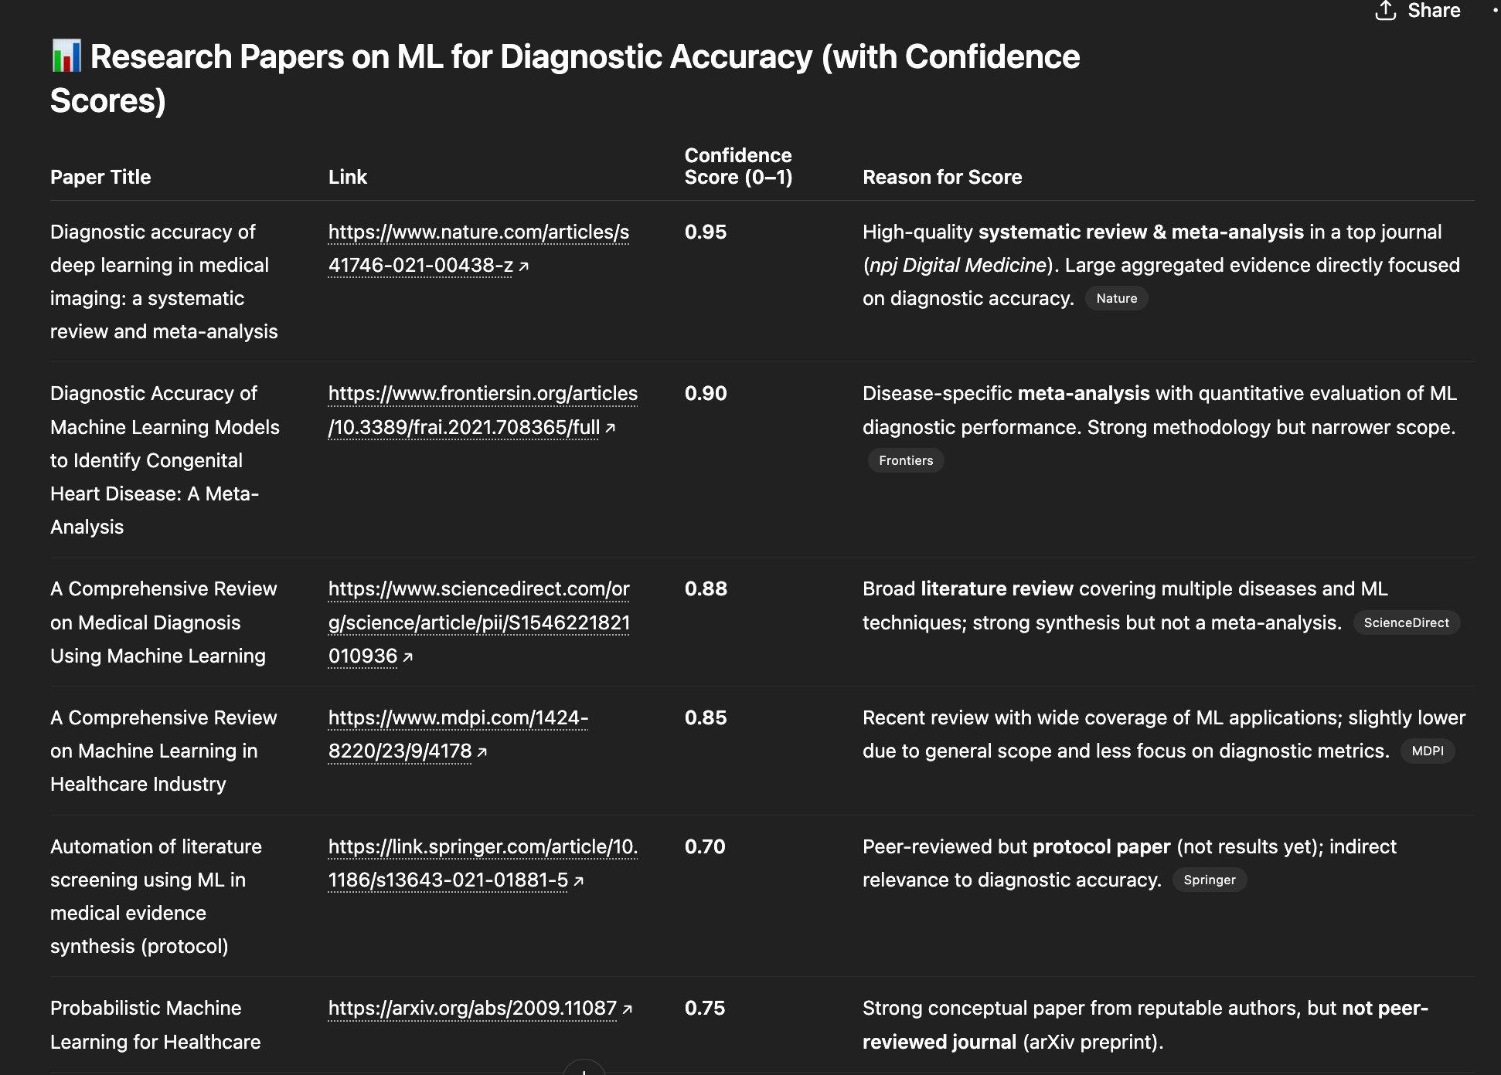
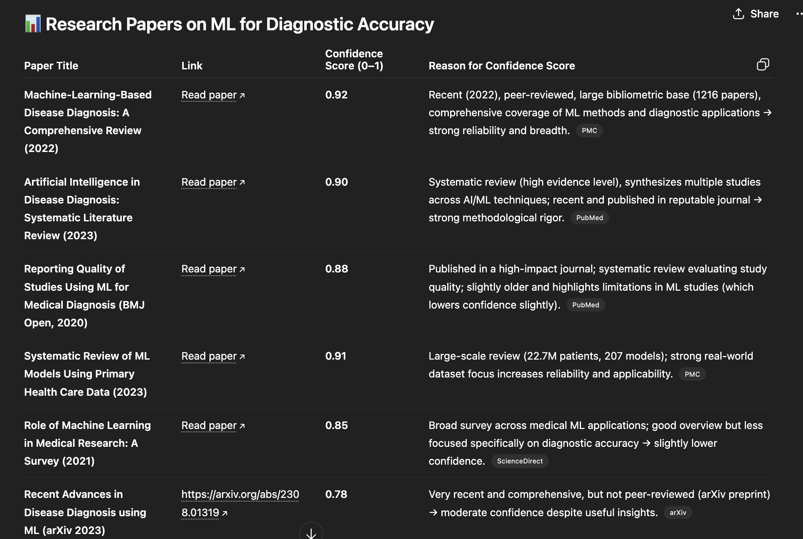
The Problem
Current tools show "confidence scores" — but where do these numbers come from?
ChatGPT Output 1
ChatGPT Output 2
University of Southern California
ScholarRAG
Notes:
When you ask ChatGPT for research papers, it gives you confidence scores — 0.95, 0.88, 0.75. Sounds precise. But ask yourself: where do these numbers actually come from?
Look at the two outputs here — same query, different scores, different reasoning. One penalizes an arXiv preprint, the other doesn't. These scores aren't grounded in any systematic, verifiable process — they're essentially the model's gut feeling, dressed up as a number.
That's the problem ScholarRAG is solving: making confidence scores mean something you can actually trust.

Slide 3
Why Trust Matters in Literature Review
Students and researchers use AI to speed up literature review
A polished answer that sounds correct may not be — and citing a paper doesn't mean the paper supports the specific claim
Users need a clear path to verification: inspect evidence sentence by sentence, see whether support is strong or weak
Especially important for early-stage researchers who are still learning to navigate the literature
If ScholarRAG works well, users can read research faster without choosing between speed and trust.
University of Southern California
ScholarRAG
Notes:
AI makes literature review faster — but faster isn't useful if you can't trust the output. A citation doesn't mean the paper actually supports the claim. Researchers, especially early-stage ones, need to verify evidence sentence by sentence. The goal is speed and trust — not one or the other.

Slide 4




Our Approach
ScholarRAG: trust by confidence, not by assertion
Sentence-Level
Citation Grounding
Per-Citation
Confidence (M/S/A)
Every answer sentence linked to a specific evidence passage — not just paper-level references
M = NLI entailment · S = retrieval stability across query variants · A = lexical corroboration, orthogonal to M
Human-Calibrated
Weights
Domain-Trust Layer
for Literature Review
Logistic regression fit on manually labeled claim-evidence pairs — not arbitrary heuristics
Not competing on general intelligence — focused on verifiable scholarly QA
University of Southern California
ScholarRAG
Notes:
"ScholarRAG's core idea is trust by confidence, not by assertion — meaning we don't just tell you something is supported, we show you the evidence and score it.
Four pillars: every answer sentence is tied to a specific passage — not just a paper. Each citation gets an M/S/A confidence score across three independent signals. Those weights are fit on human-labeled data, not guesswork. And we're not trying to beat ChatGPT at everything — we're focused on one thing: verifiable scholarly question answering."

Slide 5



System Overview - End to end
Upload
PDFs
Intent Resolver (GPT-4o-mini)
Hybrid Retrieval: Dense + Lexical (α = 0.35)
Citation Grounded
Generation
M/S/A
Confidence
Key Design Idea: Generate answers + verify + quantify trust
novelty*
Embeddings: mxbai-embed-large (Ollama) · Storage: Postgres + pgvector · Generation: GPT-4o-mini · Frontend: React/TS
University of Southern California
ScholarRAG
Notes:
SPEAKER: [eshna] ~1.5 min
Update the flow Walk through end-to-end: Upload PDFs → chunk & embed → sense disambiguation → dense retrieval + lexical rerank + doc balancing → GPT-4o-mini generates cited answer → M/S/A confidence scores → claim export for human annotation & calibration. Mention tech stack briefly.

Slide 6
Ingestion & Retrieval
Document Ingestion
Hybrid Retrieval
PDF upload via React frontend
Text extraction + overlapping chunks with page metadata
mxbai-embed-large embeddings (Ollama)
Postgres + pgvector with embedding contract metadata (provider, model, version, dim)
Prevents mixing vectors from different runs
Dense cosine + BM25 style lexical overlap fused with a=0.35
Multi-document balancing heuristics
Query intent resolution via GPT-4o-mini — extracts canonical term, inferred domain, and query variants 57-term curated lexicon retained as deterministic fallback
University of Southern California
ScholarRAG
Notes:
SPEAKER: [eshna] ~1.5 min Explain ingestion pipeline (PDF → chunks → embeddings → pgvector). Then retrieval: dense + lexical + doc balancing. Mention embedding contract metadata as an engineering detail that prevents vector mixing.

Slide 7
Citation-Grounded Generation
GPT-4o-mini with constrained prompting
Sentence-Level
Attribution
Abstain &
Hedge
Multi-Document
Synthesis
Each answer sentence tied to a specific evidence passage
Post-generation pass reviews each sentence via NLI entailment; sentences with no grounding are flagged as weak in UI
Cross-paper synthesis with per-sentence citations preserved
Grounding is not perfect — this is why the confidence module and annotation workflow are necessary
University of Southern California
ScholarRAG
Notes:
SPEAKER: [eshna] ~1 min Generation: GPT-4o-mini receives retrieved chunks, must tie each sentence to evidence. If support is insufficient, hedges/omits. But grounding isn't perfect — hence the confidence layer.

Slide 8
M/S/A Confidence Model
M
Semantic Match
S
Retrieval Stability
A
Agreement
Does evidence actually support the claim?
NLI entailment probability
between claim and cited passage
(GPT-4o-mini as classifier). Paraphrased but grounded claims are rewarded.
Does the same evidence appear across runs?
Fraction of perturbed retrieval
runs returning same evidence
(query perturbation)
Do multiple sources support it?
A = lexical corroboration - fraction of distinct document sources whose snippet shares >= 2 content words with the claim. Designed to be orthogonal to M so calibration doesnt degenerate to label as feature.
Confidence = σ( b + w₁·M + w₂·S + w₃·A )
No single signal fully captures evidence quality — that's why we use three complementary signals
University of Southern California
ScholarRAG
Notes:
SPEAKER: [eshna] ~1.5 min M = entailment (does the passage support the claim?), S = consistency (does the same evidence reappear?), A = corroboration (do other sources agree?). Combined via logistic regression. Default weights: w1=0.58, w2=0.22, w3=0.20.

Slide 9
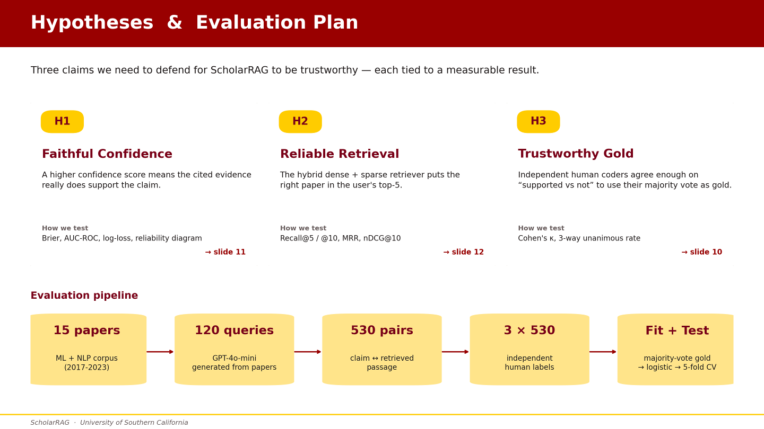

Slide 10
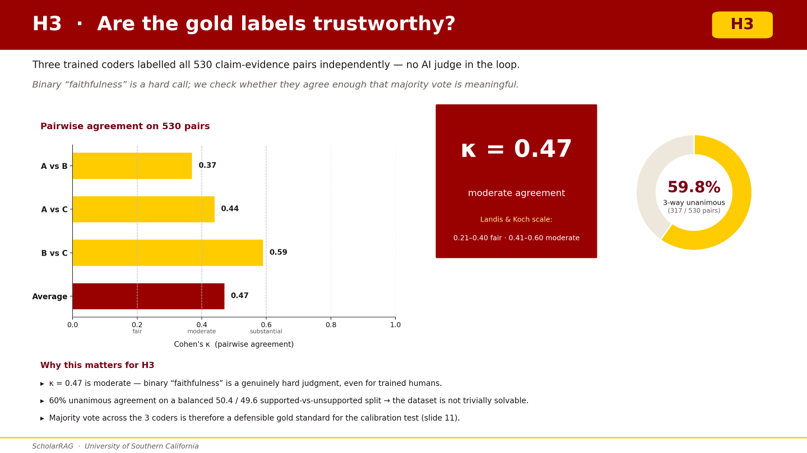

Slide 11
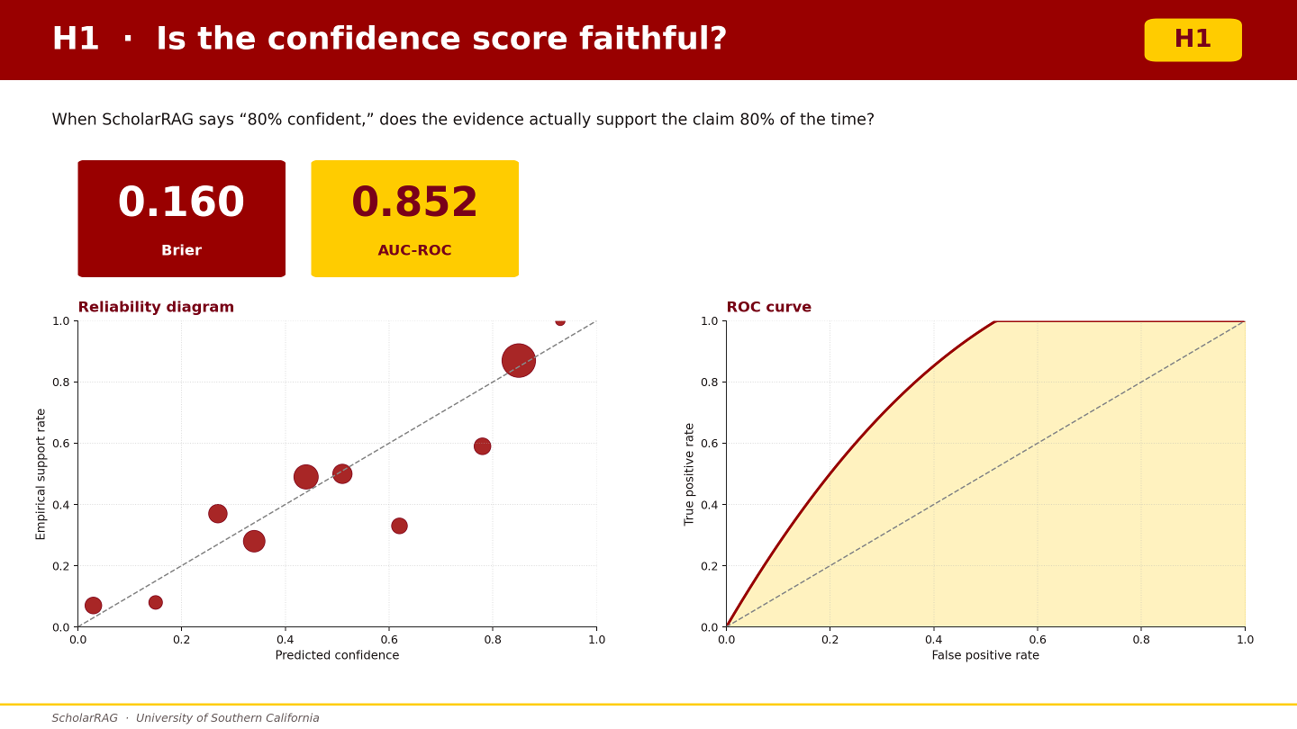

Slide 12
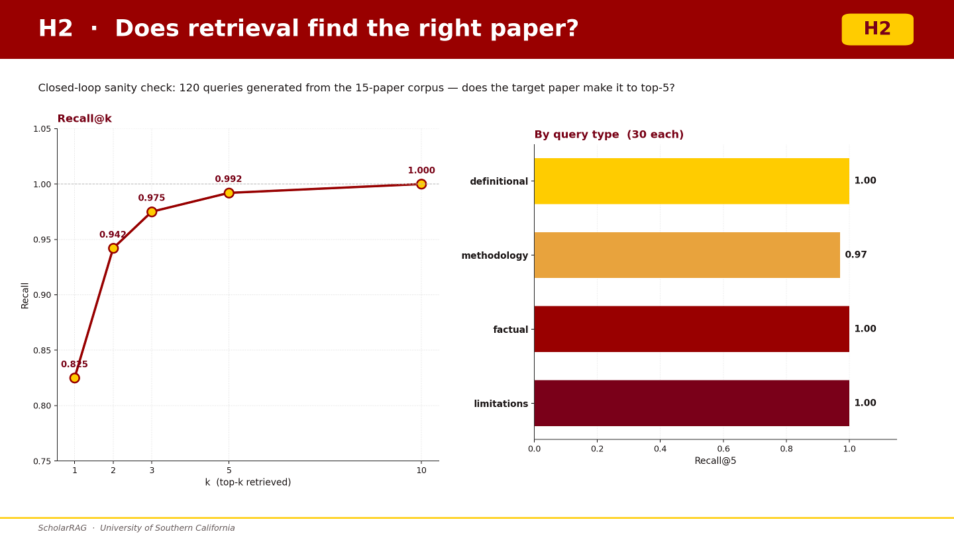

Slide 13
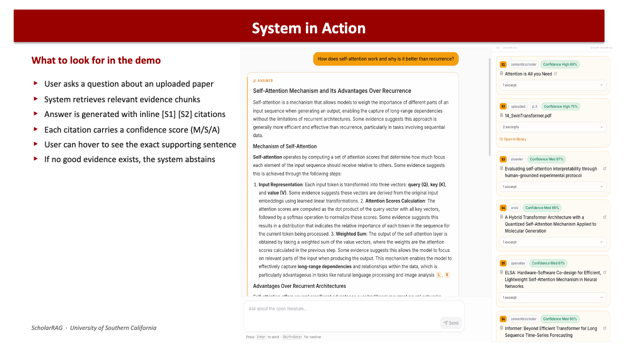

Slide 14
Current Limitations
1
Dataset is small ~530 human-labeled pairs
2
Retrieval is heuristic based: lexical reranking, dense search, document-balancing
3
Query disambiguation only handles a small set of terms
Notes:
Our dataset is small and skewed toward supported claims, which likely overstates agreement's power. Retrieval still relies on hand-tuned heuristics, and query disambiguation only covers a limited vocabulary. And M/S/A leans heavily on semantic similarity — if two documents agree but are both wrong, the system won't catch that. These are the problems our future work directly targets."

Slide 15
What's Novel
1
Sentence-level grounding
Each answer sentence tied to specific evidence — not just paper-level citations
2
Calibrated per-citation confidence
Interpretable M/S/A score per claim with logistic calibration from human labels
3
Open-corpus annotation loop
Any uploaded papers → claim export → human labels → weight fitting → inference
4
Domain-trust layer positioning
Not competing on general intelligence — focused on verifiable scholarly QA
Notes:
We ground at the sentence level — not just the paper.
We score each citation with calibrated M/S/A confidence, not a black-box number.
Our annotation loop works on any corpus you upload, so calibration isn't locked to a fixed dataset.
And we're deliberately narrow — a domain-trust layer for scholarly QA, not a general assistant. That focus is what makes the trust guarantees possible.

Slide 16

Future Directions
1
Incorporate better rerankers and embedding models for better efficiency and better Recall@k and MRR values
2
Fine tune parameters with better curated dataset (more examples, more edge cases
3
Use better research websites for retrieving high quality research papers
New Questions from This Work
Can we generalize M/S/A framework on different types of bots and check if it can reduce delusional spiraling for informed and naive users?
Notes:
SPEAKER: [Name] ~1 min Four novelty points. This maps to 15% 'novelty' rubric criterion. Emphasize the domain-trust framing.

Slide 17
Thank You
Questions?
{sdalavi, pperiche, eshnagup}@usc.edu
Notes:
3 min Q&A.

